Slide 1
Maturity Model for Microsoft 365 Practitioners
Power Platform and the MM4M365
May 2021
⭐Guest stars⭐ April Dunnam & Hugo Bernier
Emily Mancini, Sympraxis Consulting | @eemancini Marc Anderson, Sympraxis Consulting | @sympmarc
Simon Doy, iThink 365 | @simondoy
Simon Hudson, Novia Consulting | @simonjhudson
Initiative started by Sadie Van Buren as SharePoint Maturity Model in 2010
Notes:
EMILY

Slide 2

v
Agenda
Practitioner overview
Introduction to the Maturity Model
Latest artifacts for the Maturity Model
How to get more involved
Picture time with the Together Mode!
Monthly Discussion: Power Platform
Notes:
EMILY

Slide 3

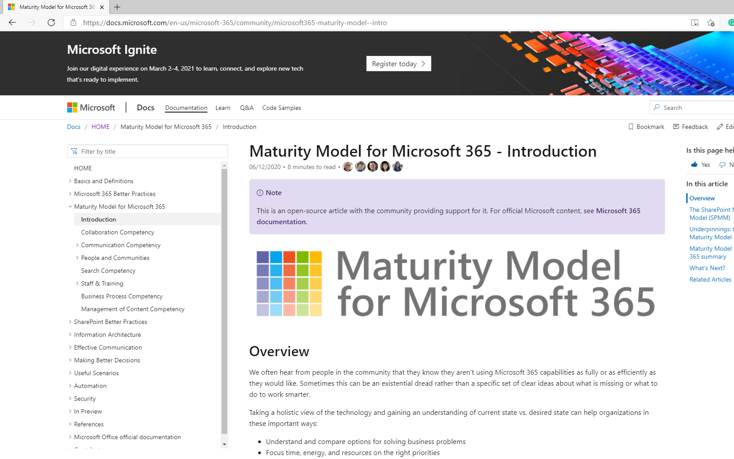
INTRO
Maturity Model
for Microsoft 365
https://aka.ms/m365-community-docs
Notes:
SIMON H

Slide 4









MM4M365 aligns the company on what can and will be done across the platform
Improve organization through use of technology
Benchmark company and department
Select appropriate approach
Develop an organizational business and technical roadmap based on:
What's possible
What's desired
Organization's culture and drivers
Lead and support strategic planning, with senior management
Align implementation needs and objectives
Discuss use of the platform with IT – not just technology
Socialization tool
Notes:
SIMON H
- Improve organization: this technology is most successful when we are using it to solve existing challenges in the organization. Maybe you are struggling with raising transparency in decision making- this is a great opportunity for SP communication sites and news.
- Benchmark company and department: provides a rubric/mechanism to measure the current state which will be critical in measuring growth and tracking ROI to share with stakeholders or decision makers. Collaboration and communication are softer topics so this develops the language to begin measuring it all. M365 is so much more than usage statistics because we are shifting the way people are working and communicating to solve these real-world problems
- Select appropriate approach - Not one size fits all. Your company size, culture, goals, and industry all have impacts of what is the right maturity level for your organization. A 6 person company may never need to be at the 500 level for Communication. This model does not dictate any levels as better than others but instead focuses on the impacts so you can choose which matter the most to support your objectives.
- Develop an organizational business and technical roadmap: Now that we know current state and identified future state, you can use the How To articles to navigate a plan to get there which enables you to lead and support strategic planning, with senior management.
- Align implementation needs and objectives- maybe you are at the beginning of your journey, your current state is Level 0 so you can choose which level you want to begin. Some organizations might need to begin at 300 for M365 to be impactful. Aligning on impact allows you to focus the tradition requirements conversation for M365 on the outcome objectives which is really about the change you are seeking in working better together.
- Discuss use of the platform with IT – not just technology: expanding IT’s understanding past the systems themselves to the outcome objectives it supports
- Social Adoption (Socialization) tool: Majority of your colleague using M365 aren’t IT professionals and don’t spend the amount of time we all do understanding the platform. The Maturity Model is a study guide version of what is possible; (like Cliff’s Notes or Dummy's Guide for technology based business process)) . Useful artifact to share with your colleagues to increase their understanding of the platform. Even better- it is community maintained reducing your individual burden of creating these resources for the org!

Slide 5
MM4M365 has evolved with the platform
Published Competencies
Open Competencies
Supporting Articles
Business Process
In progress
Principles of…
Infrastructure
Collaboration
Search
Communication
To do
Communication
Management of Content
Security…
How to elevate…
People & Communities
Data & Analytics
Collaboration
Search
Communication
Staff & Training
People & Communities
Customization & Development
Staff & Training
Notes:
SIMON H

Slide 6
MM4M365 provides benchmarks to measure your organization
Maturity Level | Description | Keywords
Level 500 Optimizing | Deliberate and systematic process improvement/optimization Focus is on continually improving process performance Addressing statistical common causes of process variation and iterative process improvement | Optimal, systematic, statistical, improvement-focus, automated, assured, proactive
Level 400 Predictable | Actively managed in accordance with agreed processes and has tracked metrics Effective achievement can be evidenced across a range of operational conditions Process has been tested and refined Process users demonstrate competence | Productive, interactive, responsive, enhanced, effective, adaptable, quality
Level 300 Defined | Defined and standardized Signed off, managed process Limited validation of effectiveness, doesn’t include edge cases Process users demonstrate familiarity | Documented, policy-driven, planned, controlled, stable
Level 200 Managed | Key processes defined but not standardized, uniformly or strongly applied Some ability to demonstrate consistent outcomes Limited buy-in from staff and management Widespread inconsistency and resistance | Routine, legacy, fire-fighting, variable, personally managed
Level 100 Initial | Default, starting/exploratory state People driven processes, lacking documentation and discipline Many ways of doing the same thing (with variable results) Characterised by inefficient legacy approaches and pockets of unmanaged innovation | Ad hoc, reactive, uncontrolled, chaotic, unstable, not designed
Source: https://docs.microsoft.com/en-us/microsoft-365/community/microsoft365-maturity-model--intro
Notes:
SIMON H

Slide 7
OVERVIEW
Practitioners for
Maturity Model
for Microsoft 365
https://aka.ms/sharing-is-caring
Notes:
EMILY

Slide 8
Practitioners of MM4M365
Safe space to hone your pitch, test your thoughts, or decide how to promote your use of the Maturity Model
Discussion-based monthly meeting
Highlights of new assets
Understanding the competencies
Mapping technology to maturity levels and competencies
Running a workshop
Measuring maturity
Sharing anecdotes and success stories
Feedback on the maturity model
Notes:
EMILY

Slide 9
OVERVIEW
Get involved in the
Maturity Model
for Microsoft 365
https://aka.ms/sharing-is-caring
Notes:
MARC

Slide 10
Opportunities to participate in the community
Present case study (at MM4M365 Practitioners or other speaking opportunities)
Contribute on GitHub
Provide feedback, insights, tools, and artifacts
Socialize
content
Notes:
MARC

Slide 11
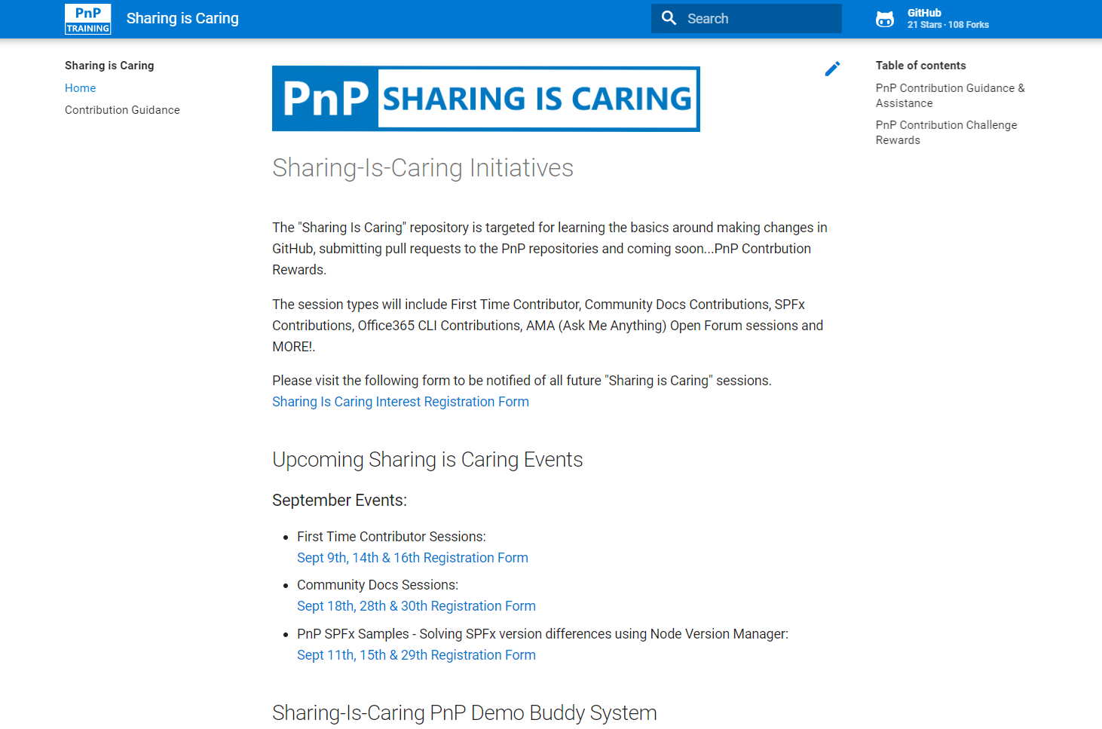

GUIDANCE
Want to get started on the open-source and community work?
Thank you, April attendees
Community Docs Sessions
Wednesday, May 19th
First Time Contributor Sessions
Monday, May 24
Agustin Del Vento
Andrew Burns
Andy Boylan
Chris Revell
Christine Green
Daniel Westerdale
Gissur Simonarson
Harold Wolfinger
Henrik Yllemo
Jasper Voskuilen
Jenna McGee
Joy Muehlenbein
Kathleen Boilek
Luke Pfaffinger
Manoj Kumar Mittal
Matthew Tracy
Mike Duffy
Patrick Dillinger
Phil Broadbery
Ralph Rivas
Ross Allan
Shiva Bezwada
Tim Mayo
Troy Meacham
https://aka.ms/sharing-is-caring
Notes:
EMILY

Slide 12
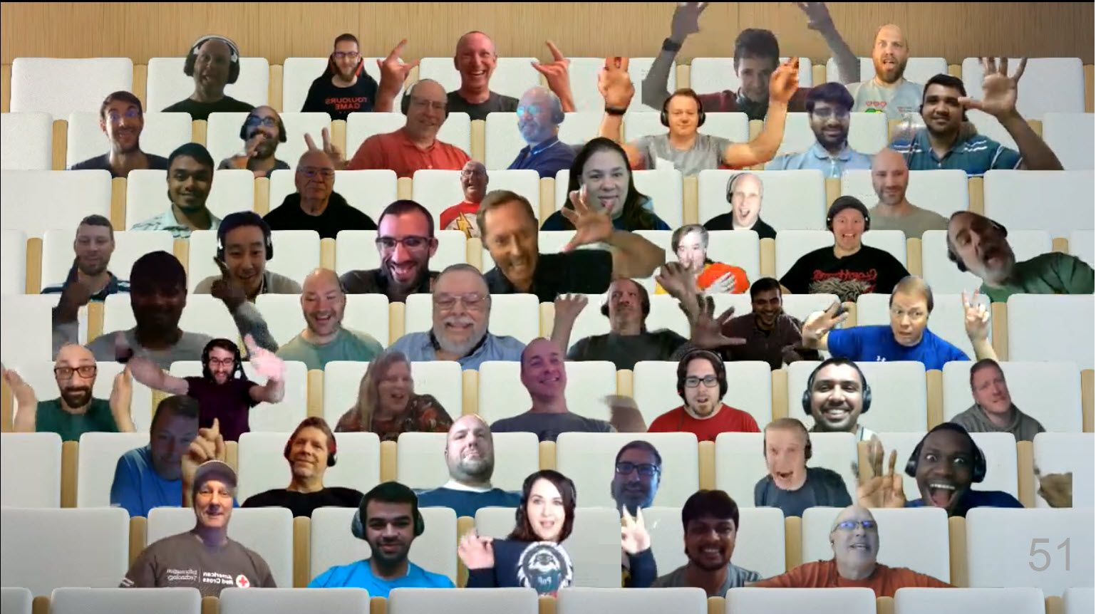

Optional picture time!
Video on and we’ll grab a Together Mode pic with those who are willing to do this.
We are together in this as a community!
Notes:
EMILY

Slide 13
Next MM4M365 monthly call
June 15th at 7:00am PST
Third Tuesday of every month
https://aka.ms/sharing-is-caring
Management of Content
Notes:
EMILY

Slide 14
DISCUSSION
Power Platform through the lens of the Maturity Model
Notes:
SIMON D
Discuss the approach and how when first thinking about how to apply the maturity model it was all about the customisation and development competency. So when we are discussing the Power Platform we are think ingabout all the competencies and how they are applied from the maturity model.
Examples:
Communication – how do we inform people that the Power Platform is available? How we explain what the benefits and impact of the platform can be?
Staff and Training – how we we enable our teams to take advantage of the platform? What training is there, do we sign post to internal teams, external teams, on-line resources, do we buy courses via content providers such as linda.com or pluralsight or linked in learning....
Management of content – how do we manage the content related to the Power Platform the user guides / admin guides
People and Communities – we will talk about this more later but how do we enable people and communities around the Power Platform flourish and build a support network for the Power Platform citizen developers
Business Process -
Collaboration – How do we enable people to work together on these systems and describe what they want, what has been done etc.
Before we get into the discussion lets talk about what the Power Platform is.

Slide 15
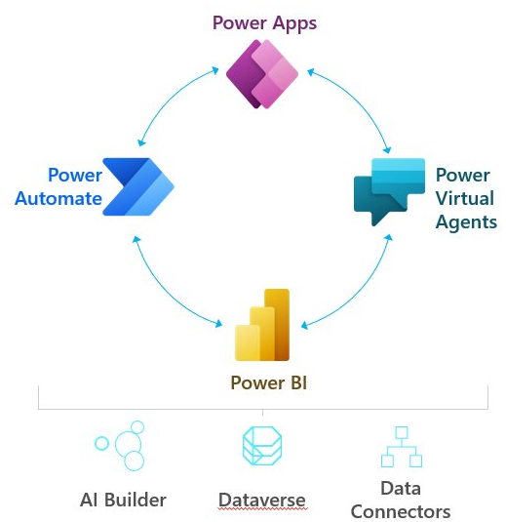
What is the Power Platform?
Dataverse
Notes:
SIMON D

Slide 16
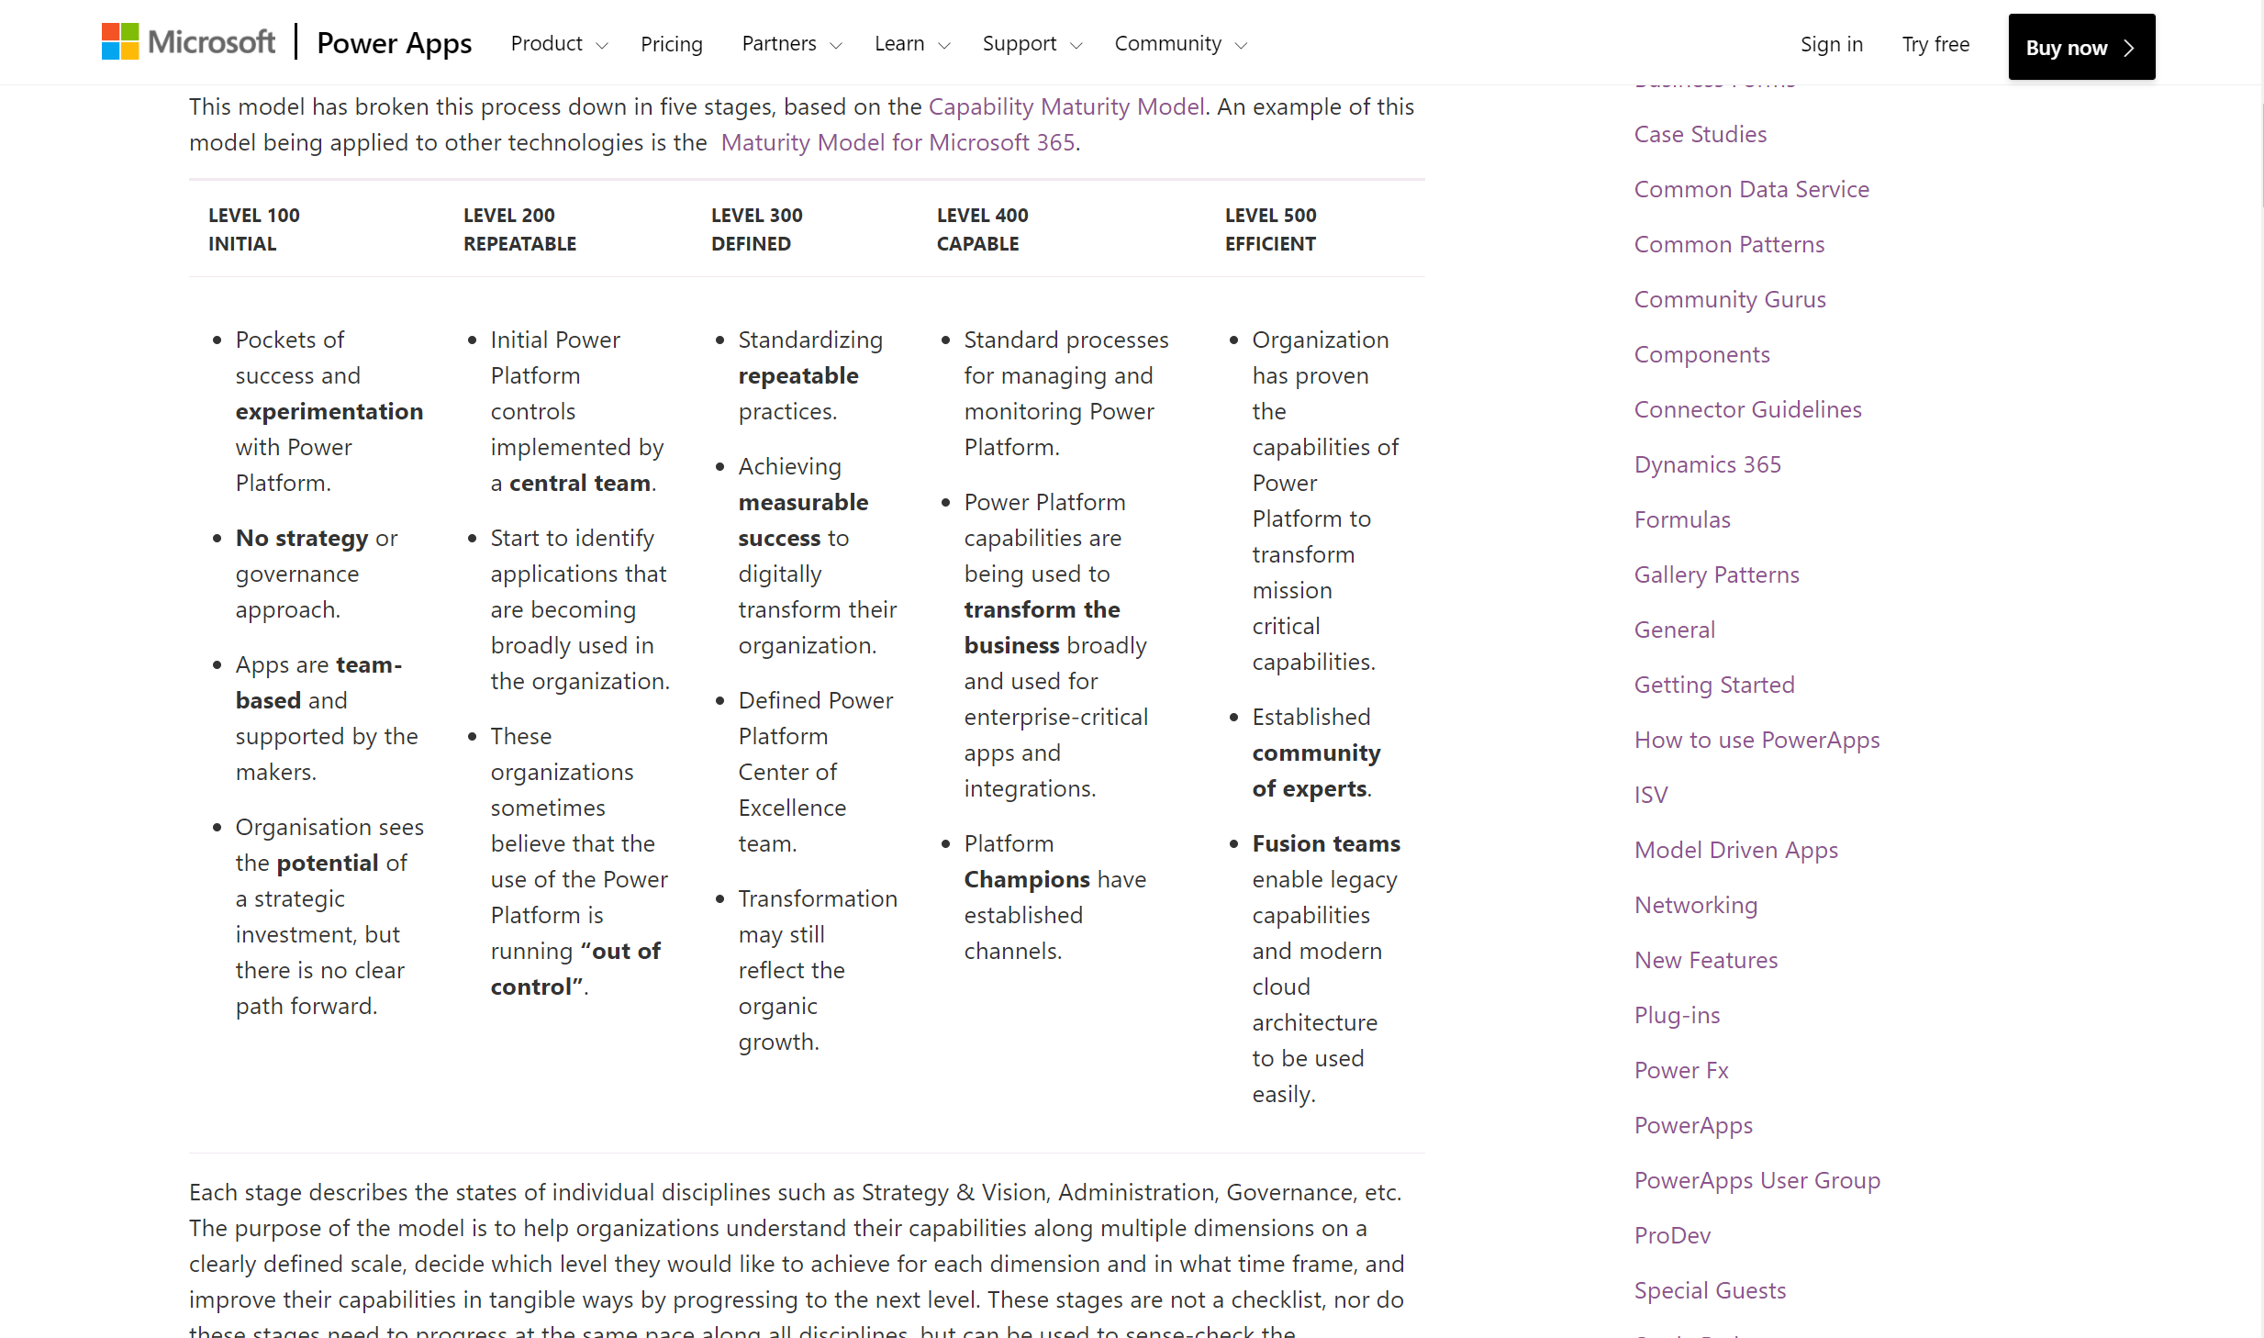
RESOURCE
Power CAT Adoption Maturity Model
https://symp.info/PowerCATMaturityModel
Notes:
SIMON D
Discuss the maturity model.
Quick overview
Goals and Opportunities for each level.
100
- Getting sponsors
- Training events
- find and nuture the champions
200
- gain oversight of tenant
- establish dlp policies
- welcome new makers and sign post them to the resources
300
- establish centre of excellence
- environment strategy
- support model
- Success stories
400
- app catalog
- automate comms between coe, it and admins
- define responsibiltiies for CoE
500
Simple ALM
Enable Ideas and Suggestions to be submitted
Enable people to tell their story
Please check it out and pass your thoughts and feedback to the CAT team.

Slide 17
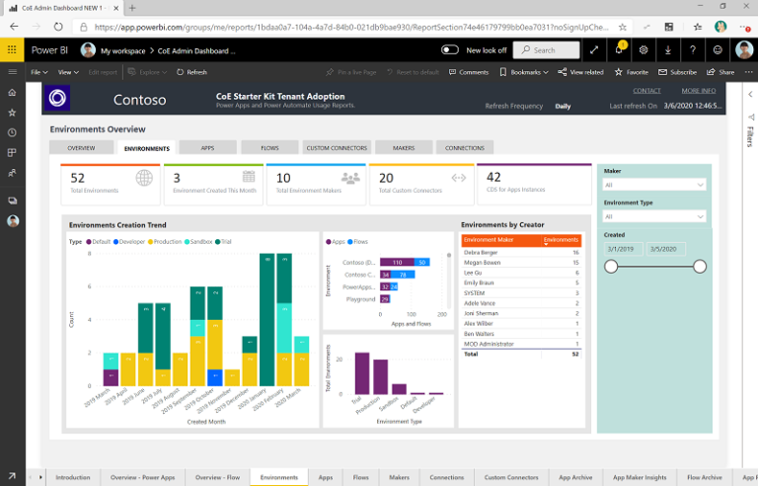
Power Platform Center of Excellence
Core components
Governance components
Nurture components
Standalone add-ons:
Theming components
Application lifecycle management components
Innovation backlog components
https://docs.microsoft.com/power-platform/guidance/coe/setup
Notes:
APRIL
300 level
Set up when first rolling out power platform to govern, manage, and nurture
Logging and analytics, DLP, set up training

Slide 18
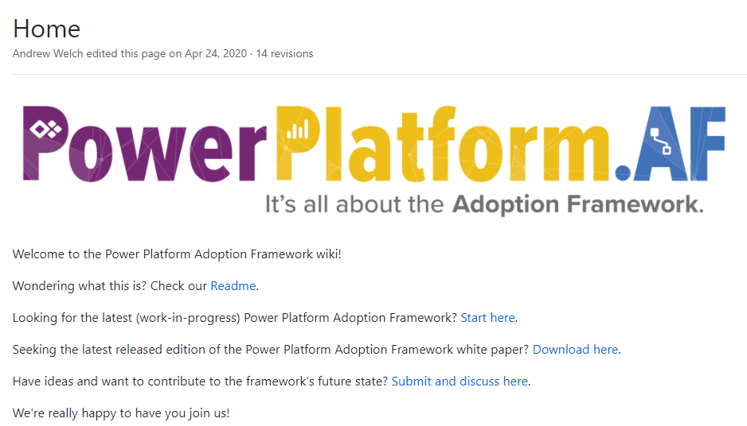
RESOURCE
Power Platform Adoption Framework
PowerPlatformAF/PowerPlatformAF: Power Platform Adoption Framework (github.com):
https://github.com/PowerPlatformAF/PowerPlatformAF
Power Platform Adoption Framework —Andrew D Welch:
https://www.andrewdwelch.com/powerplatformaf
Notes:
HUGO
The framework is supported and driven by its original creator (Andrew Welch) and publisher Applied Information Sciences (AIS) -- Microsoft Partner -- and contributed to by Power Platform experts and citizen developers around the world (Manuela Pichler, Keith Whatling, Lee Baker, and Lucy Bourne are some major luminaries on this topic - follow them!)

Slide 19



Maturity Model Adoption Best Practices
Strategy & Vision:
-Establish a Center of Excellence
-Roles & Responsibilities
-Delivery models
Admin & Governance:
-Manage
-Secure
-Monitor & Alert
Nurture best practices:
-Community
-Evangelism
-Training
Notes:
SIMON D
300 – Centre of Excellence, Roles and responsibilities within the CoE, Define how applications are delivered within the organisation – what support is provided, who to ask, how to get support.
Admin & Governance
How do we know what is available to users, how do we communicate the roadmap
How do we secure the organisation and ensure that data is not going to leak out out from the Power Platform.
Nuture best practices
- For this to work we need to build a community, create a sense of belonging

Slide 20

DISCUSSION
Share reactions while others are speaking
Come off mute and share your thoughts
Share your camera, we love virtually meeting you
Raise your hand if someone is speaking

Slide 21
DISCUSSION #1: Where do you start with the Power Platform?
Notes:
POLL: https://forms.office.com/r/DmUk6zw2NZ
Would you choose a particular part of the platform?
Source control?
Switch it on and let everyone go wild?

Slide 22
DISCUSSION #2: How do you support the citizen developers at your organization?
Notes:
POLL: https://forms.office.com/r/YNYVUxcjZE
It is the wild west- there is no oversight
We provide some documentation but no oversight
We have a request process for support (internal or external)
There is no development without IT support

Slide 23
DISCUSSION #3: What does a successful Power Platform implementation look like at your organization?
Notes:
POLL 3: https://forms.office.com/r/QiBpTYFCqm
No training support
Microsoft Learn
Learning Pathways
Online training (ex Plural Sight)
In-person Training

Slide 24
DISCUSSION #4: Do you need source control for the Power Platform?
Notes:
POLL 4: https://forms.office.com/r/etN21ZR2NY

Slide 25
DISCUSSION #5: What roles need to be involved in development on the Power Platform?
Notes:
POLL 5: https://forms.office.com/r/GqxkSuM26Q
- Solution Architect - Department Team Lead
- Project Sponsor
- Power Users within a business focused department?
- IT Support?
- Developer?
- IT Security

Slide 26
DISCUSSION #6: What are the biggest problems to integrating low code, no code, pro code approaches?
Notes:
POLL 6: https://forms.office.com/r/2d1Ptq1rRs

Slide 27
Thank you
Follow us on Twitter
@M365Maturity | @M365CommDocs
Take the Maturity Model Self-Assessment
https://symp.info/MM4M365-SelfAssessment
Fill out the Maturity Model Survey
https://symp.info/MM4M365Survey
Discussions in Github
https://symp.info/MM4M365Discussion
Next MM4M365 monthly call: June 15th at 7:00am PST
Third Tuesday of every month
https://aka.ms/sharing-is-caring

Slide 28


aka.ms/m365pnp

Slide 29
Capability Maturity Model (CMM) provides benchmarks to measure your organization
Level 500
Optimizing
Focus on process improvement
Level 400
Quantitatively Managed
Processes are measured and controlled
Level 300
Defined
Processes documented for the organization and is proactive
Level 200
Managed
Processes documented for projects and often reactive
Level 100
Initial
Processes unpredictable, undocumented, poorly controlled and reactive
Source: https://en.wikipedia.org/wiki/Capability_Maturity_Model_Integration
Notes:
The MM4M365 is based on the Capability Maturity Model which was created in 1986.
The CMM was designed to help organizations build better software and is founded in software development process and has 5 levels running from Level 1 to Level 5, the Holy Grail (and often as elusive!).
Level 1 - Initial
The model starts at Level 1 which is the intro level, where things are chaotic and processes are not documented, poorly controlled and react to the environment that they exist within.
Level 2 - Managed
Managed is where things start to improve and some effort is made to document the processes. However, the processes are not enforced and vary from one area of the business to another. The processes are still not well thought out and are often reacting to their environment.
Level 3 – Defined This really takes us up a notch and processes are documented and now enforced so that they are consistent across the organization. More thought has been put into them and they are proactive.
Level 4 – Quantitatively Managed
This level takes those documented processes which are being consistently applied across the business and adds measures to them so that we can see how effective they are. Its interesting to see how these principles are so similar to agile approaches.
Level 5 – Optimizing
As I mentioned this is the holy grail now that we have measured processes in place we can start to tweak the process and see how that affects their performance. We can experiment and choose the tweaks which provide improvement.

